Slide 1

Ryan Deguara C20309873
TU856
Heart Disease study

Slide 2

Data Cleaning
Excel:
Remove duplicates: no duplicates found.
Sorted data by largest to smallest, highlighted values over 115 for glucose – removed any outliers.
Find & Select -> Special -> Blanks: No blanks found.
Find & Select – NA -> Removed all null values.
=IF(H2="none", 0, 1) to identify “Hyp prevalent” column.
=IF(G2="no",0,1) to identify “Stroke prevalent” column.
High blood pressure, over 50 Query
age | glucose | HYP
59 | 88 | 1
59 | 103 | 1
61 | 103 | 1
61 | 65 | 1
63 | 45 | 1
63 | 79 | 1
65 | 87 | 1
67 | 74 | 1
Access:
Imported CVD Data and created a query for Women over 50 who have High Blood Pressure prevalent to see their glucose levels.

Slide 3
Summary statistics
There are 22 women less than or equal to the age of 50 and 17 women over the age of 50.
56% of women in the data set are less than or equal to the age of 50, 44% of women in the data set are over the age of 50.
Applications used:
=COUNTIF()

Slide 4
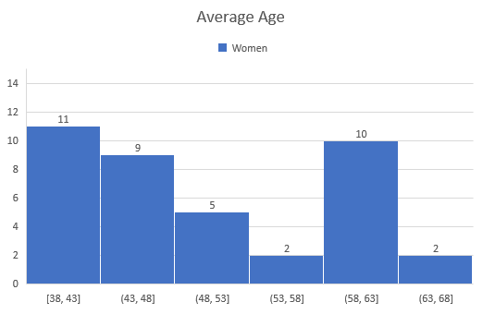
Average Age
The average age of the data set is 51.
The range of ages are from 38 to 68.
Applications used:
=AVERAGE()

Slide 5
Glucose and Diastolic Blood Pressure Levels
Correlation coefficient of age and diastolic blood pressure is 1.54.
Correlation coefficient of age and glucose pressure is 1.62.

Slide 6

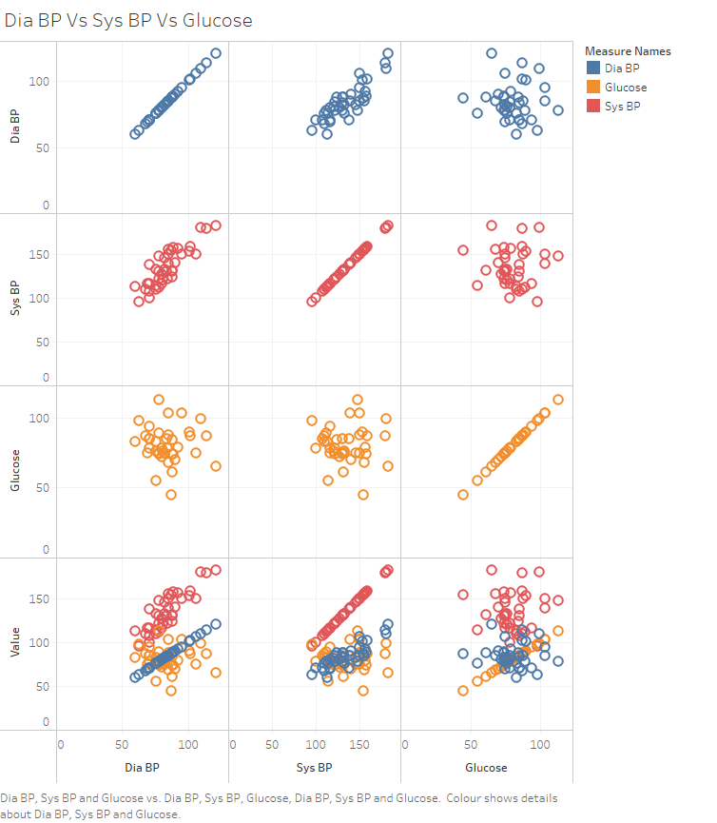
Dia BP Vs Sys BP Vs Glucose
Bottom row shows all above graphs in one graph.
No Outliers prevalent.
Glucose and Dia BP graphs dense area very similar.
Sys BP values relatively higher than the other data sets.
Applications used:
Tableau

Slide 7
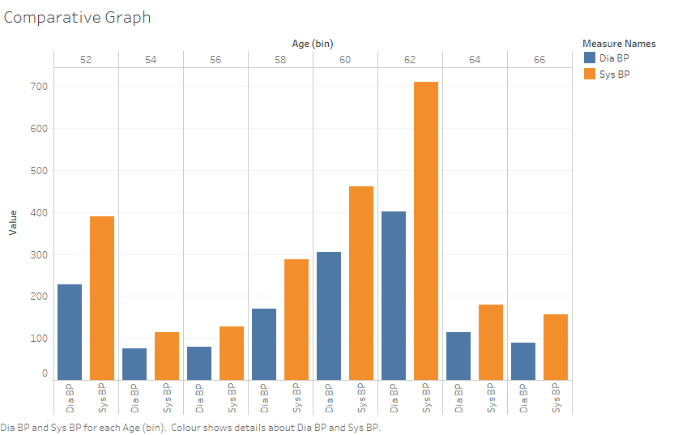
Diastolic and Systolic Blood Pressure
Values measured in mmHg for all women over the age of 50.
Range of ages was from ages 50 to 66.
Systolic values dominant over diastolic values.
Applications used:
Tableau

Slide 8
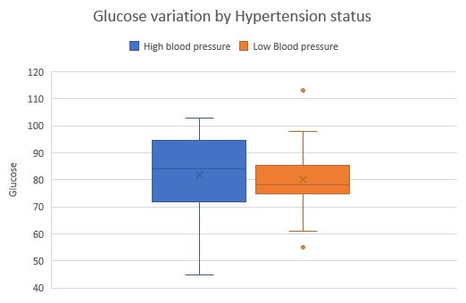
Comparative box plots by hypertension status
Range of values of glucose for applicants with high blood pressure higher and lower than comparative low blood pressure applicants.
Boxplot of people with high blood pressure much larger than the boxplot of people without.

Slide 9
Hypothesis Test – t-Test
Hypothesis test to determine if glucose levels of women under 50 are higher:
t-Test: Two-Sample
 | Women Over 50 | Women Under 50
Mean | 80.0625 | 81.42857
Variance | 305.6625 | 93.55714
Observations | 16 | 21
Hypothesized Mean Difference | 50
df | 22
t Stat | -10.5827
P(T<=t) one-tail | 2.13E-10
t Critical one-tail | 1.717144
P(T<=t) two-tail | 4.27E-10
t Critical two-tail | 2.073873
H0: Glucose levels of women over 50 are higher.
H1: Glucose levels of women under 50 are higher.
Average glucose levels of women over 50 is 80 and under 50 is 81.
Therefore we reject the null hypothesis because the average of the glucose levels of women under 50 are higher.
Applications used:
Data Analysis -> t-Test

Slide 10
Is there a predictive value?
As seen in the chart of data there are no predictive values present in relation to glucose levels because all the data sets p-values are not less than 0.15.
BMI was close to having a p-value less than 0.15, with more data we may be able to have a predictive value in relation to glucose levels for BMI.
 | Coefficients | Standard Error | t Stat | P-value | Lower 95% | Upper 95% | Lower 95.0% | Upper 95.0%
Intercept | 107.5143337 | 30.5236526 | 3.522328573 | 0.00131102 | 45.33968795 | 169.688979 | 45.33968795 | 169.6889794
Age | -0.336357341 | 0.29288138 | -1.148442212 | 0.25929878 | -0.93293719 | 0.26022251 | -0.93293719 | 0.260222509
totChol | -0.017510658 | 0.062635668 | -0.279563679 | 0.78161138 | -0.145095337 | 0.11007402 | -0.14509534 | 0.110074022
sysBP | 0.151121094 | 0.234828153 | 0.643539082 | 0.52445994 | -0.3272082 | 0.62945039 | -0.3272082 | 0.629450388
diaBP | -0.404056673 | 0.36912072 | -1.094646417 | 0.28184279 | -1.155930975 | 0.34781763 | -1.15593097 | 0.347817628
BMI | 0.91177502 | 0.644286249 | 1.415170697 | 0.1666771 | -0.400593123 | 2.22414316 | -0.40059312 | 2.224143163
Heart Rate | -0.206273829 | 0.225137926 | -0.916210933 | 0.36640973 | -0.664864778 | 0.25231712 | -0.66486478 | 0.252317119
Applications used:
Data Analysis -> Regression

